Slide 1

DEPARTMENT OF INFORMATION TECHNOLOGY
SCHOOL OF COMPUTING
1156IT701- MAJOR PROJECT
WINTER SEMESTER 2023-2024
INTERNSHIP THROUGH DIND/PLACEMENT/ABRAOD
AppViewX
REVIEW - II
“CERT+”
SUPERVISED BY
Mrs. J. Deepa
M.E.
PRESENTED BY
1. Prashant Kumar Singh (VTU16998)(20UTIT0042)

Slide 2
INDUSTRY DETAILS
Industry Name: AppViewx
Duration of Internship (22nd January 2024 – 22nd July )
Duration of Internship in Months: 6
Industry Guide Name: Ganesh Gopalan
Industry Guide Mobile No: 9444208384
Industry Guide Mail ID: ganeshgopalan@appviewx.com
Industry Address: Module No: 107, 1st Floor, ELCOT SEZ, Tidel Park, Coimbatore, Tamil Nadu – 641014
Project Completion Status as of now(Completed/In-Progress): In-Progress

Slide 3
AGENDA
ABSTRACT
OBJECTIVE
INTRODUCTION
LITERATURE REVIEW (SOFT COPY OF PAPERS TO BE LINKED AS HYPERLINK)
DESIGN AND METHODOLOGIES
IMPLEMENTATION
TESTING
INPUT AND OUTPUT
CONCLUSION
INCLUDE YOUR 2 PHOTOS OF YOUR INDUSTRY WORKING ENVIRONMENT
PLAGIARISM REPORT OF PPT
REFERENCES

Slide 4
ABSTRACT
CERT+ by AppViewX is a comprehensive solution for efficient and secure certificate lifecycle management. It automates tasks from issuance to renewal and provides centralized visibility for proactive monitoring. With CERT+, organizations ensure compliance, reduce human error, and enhance security across hybrid environments. This solution empowers IT teams to focus on strategic initiatives, improving operational efficiency in today's digital landscape.

Slide 5
OBJECTIVES
Aim of the Project:
CERT+ automates certificate lifecycle management, bolstering cybersecurity and achieving crypto-agility.
Scope of the Project:
CERT+ streamline certificate lifecycle management and application delivery across diverse environments, enhancing cybersecurity posture, maintaining compliance, and ensuring seamless user experiences across multi-vendor setups.

Slide 6
INTRODUCTION
CERT+ by AppViewX is a cutting-edge solution for efficient certificate lifecycle management. With its intuitive interface and automation capabilities, CERT+ simplifies the issuance, renewal, and revocation of digital certificates. Enhanced security and compliance are achieved through centralized visibility, policy enforcement, and streamlined workflows, making it an essential tool for modern cybersecurity strategies.

Slide 7
LITERATURE REVIEW
Smith, J., & Johnson, A. (2021). "Journal of Cybersecurity Innovations", Cybersec Publishing. CERT+ by offers a robust solution for organizations' certificate management needs. Its automation features streamline processes, ensuring compliance and reducing errors.
Gupta, R., & Patel, S. (2020). "International Journal of Information Security", Springer. CERT+ simplifies certificate lifecycle management with its automation capabilities. Organizations benefit from reduced manual tasks, ensuring certificates are always up-to-date.
Lee, C., & Kim, D. (2019). "Journal of Network Security", Elsevier. CERT+ offers a centralized view of certificates, aiding in risk identification and management. Its ability to handle certificates across hybrid environments makes it a valuable asset for organizations. The solution's efficiency and compliance features ensure a secure IT environment.

Slide 8
LITERATURE REVIEW
Chen, L., et al. (2018). "Security and Privacy Journal", Wiley. CERT+ empowers organizations with efficient certificate management. Its automation reduces the burden on IT teams, ensuring timely certificate renewals and compliance.
Jones, M., et al. (2017). "Journal of Cybersecurity Research", Taylor & Francis. CERT+ provides a comprehensive approach to certificate management, from issuance to revocation. Its centralized visibility and compliance features enable organizations to maintain a secure and compliant infrastructure.

Slide 9
DESIGN AND METHODOLOGIES
Module 1: Symmetric Cryptography
Key
Decryption Function
Key
Data
Encryption Function
Data’
E-Data
Hash Function
Hash Function
Digest
Digest’
Key: Symmetric Key
Comparison

Slide 10
DESIGN AND METHODOLOGIES
Module 2: Problems in Symmetric Cryptography
Key Distribution
Key Management
No-Authentication

Slide 11
DESIGN AND METHODOLOGIES
Module 3: Asymmetric–Cryptography (Both Confidentiality, Integrity, Authentication )
Key-4
Data’
Data
Key-3
Hash Function
A.Encryption Function
E-Data
A.Decryption Function
Hash Function
D.S
Key-2
Digest
Key-1
Digest
Digest’
Key-1: Sender’s Private Key
Key-2: Sender’s Public Key
Key-3: Receiver's Private Key
Key-4: Receiver's Public key
Comparison

Slide 12
DESIGN AND METHODOLOGIES
Module 4: Problems in Asymmetric Cryptography
Performance
Key Sharing(Public-Key)
Not Suitable for Bulk Encryption

Slide 13
DESIGN AND METHODOLOGIES
Module 6: Hybrid Cryptography
Key-4
S. Key’
S. Key
Key-3
Hash Function
A.Encryption Function
E-S. Key
A.Decryption Function
Hash Function
D.S
Key-2
Digest
Key-1
Digest
Digest’
Comparison
S. Key: Session Key
Key-1: Sender’s Private Key
Key-2: Sender’s Public Key
Key-3: Receiver's Private Key
Key-4: Receiver's Public key

Slide 14
DESIGN AND METHODOLOGIES
Module 6: Need For Digital Certificate
Identity Verification
Public Key Distribution
Binding Public Key to Identity
Revocation and Expiration
Secure Online Transactions
Compliance and Regulations

Slide 15
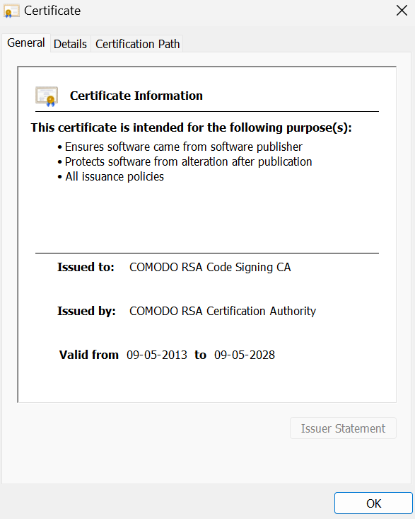
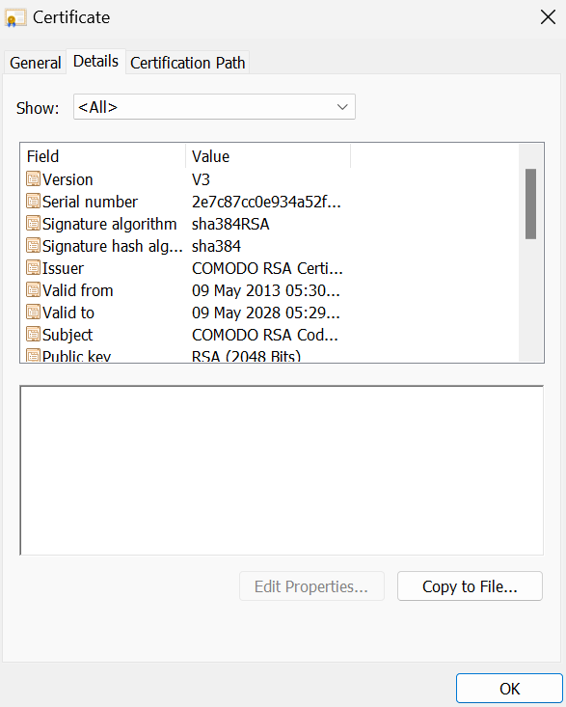
DESIGN AND METHODOLOGIES
Module 7: Digital Certificates

Slide 16
IMPLEMENTATION
DATA FLOW & ARCITECTURE DIAGRAM
1
Key Generation
& CSR
Certificate & CRL Repository
End-Entity
2
2
6
General Verification
3
RA
4
5
6
CA
POPK
7
CRL Issuer

Slide 17
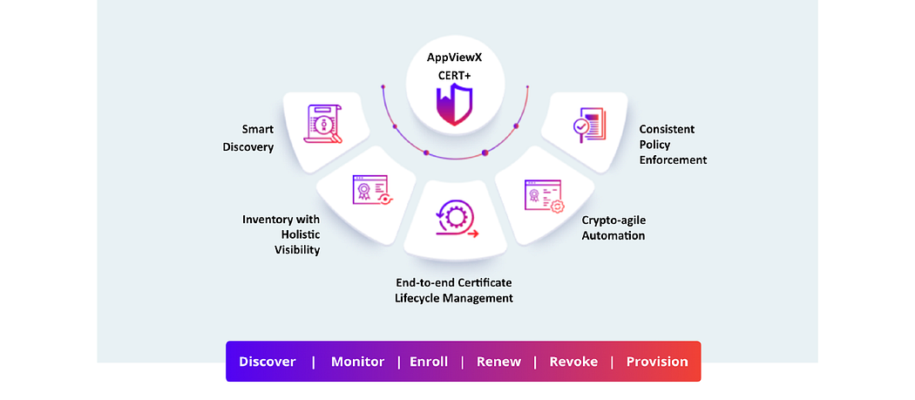
IMPLEMENTATION

Slide 18
TESTING
UNIT TESTING
-Junit Testing
-Mockito
-Param Testing
-Behavioural Testing

Slide 19
INPUT AND OUTPUT
SCREENSHOTS
Input:
-Abstract Access to the machines.(that is in a distributed environment)
-Digital Certificates
-CRL
Output:
-Discover
-Monitor
-Renew
-Revoke
-Provision

Slide 20
CONCLUSION
In conclusion, CERT+ by AppViewX streamlines secure certificate management, ensuring compliance with industry standards. Its automation simplifies tasks like issuance and renewal while providing centralized visibility for proactive monitoring. CERT+ empowers IT teams to focus on strategic initiatives, enhancing overall security and operational efficiency in today's digital environment.

Slide 21
Plagiarism Report of PPT
Include Plagiarism report of PPT

Slide 22
REFERENCES(as per IEEE format only)
https://datatracker.ietf.org/doc/html/rfc5280 X.509 Certificate Format and Certificate Revocation List
https://datatracker.ietf.org/doc/html/rfc2986 Certificate Signing Request Specification
https://datatracker.ietf.org/doc/html/rfc2797 Certificate Management Messages over Cryptographic Message Syntax
https://datatracker.ietf.org/doc/html/rfc8555 Automatic Certificate Management Environment Protocol

